Slide 1
State Leadership Project:
Outreach and Technical Assistance Network (OTAN)

Slide 2
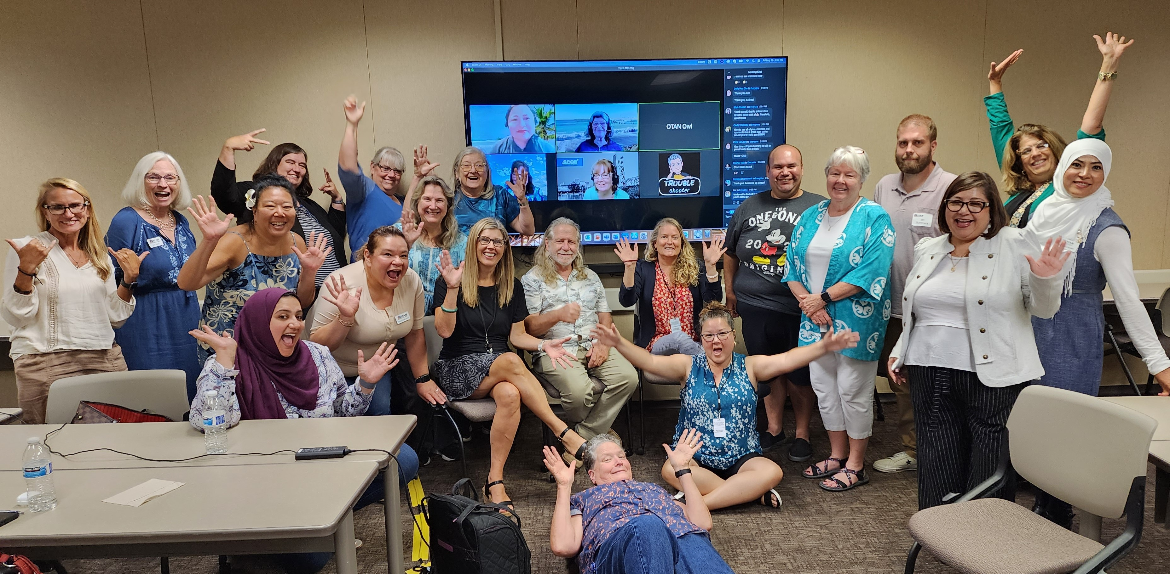
OTAN celebrates 34 years!

Slide 3
WHAT is OTAN?
OTAN is one of three state adult ed leadership projects in California.
Vision: Leading Adult Education through support for and the effective application of technology.
Please share what you learn today with your colleagues!

Slide 4
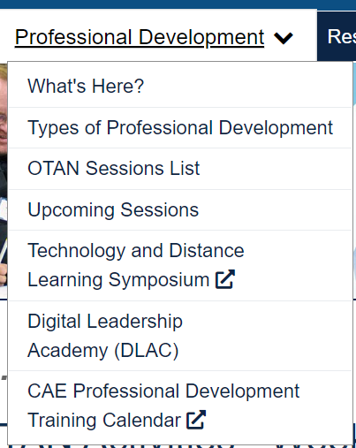
AGENDA
What is OTAN? … Our OTAN website (www.otan.us) and Membership
OTAN's Teams – Development & Training
Explore Teaching Tools and Resources
Learn about training opportunities (F2F, online, DLAC, Tech Talks)
Stay connected with OTAN after today's presentation

Slide 5
membership
Become a member to stay in touch and access resources
Stay Connected with OTAN by becoming a member.
Access monthly OTAN Digests.
Access quarterly OTAN Newsletters.
Join us on Social Media!

Slide 6
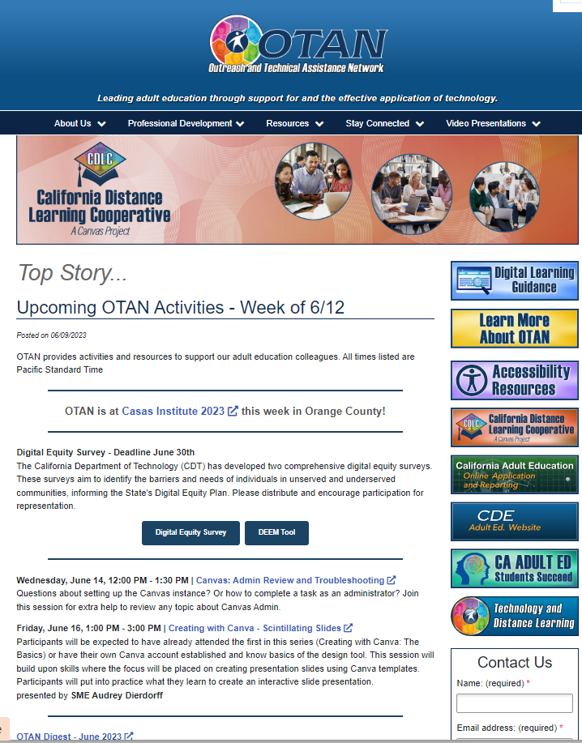
Otan homepage

Slide 7
ONLINE ApPLICATION & REPORTING
Online Application & Reporting
Online Application & Reporting website
WIOA yearly activities: applications, grant award notifications (GANs), budgets, expenditure claim reports (ECRs)
Course approvals (K-12 Districts and COEs)
Communication and resources

Slide 8
OTAN development
Websites FOR THE FIELD
OTAN - communication, resources, and news
AE Provider Directory – find a school tool
EL Civics Exchange – allow educators to share resources
California Adult Education Professional Development Calendar - training calendar
Lesson Plan Builder - create lesson plan outlines
Adult Ed Students Succeed – annual recognition of students

Slide 9
tools and resources
There are many tools and resources under this tab
On the OTAN homepage, click on the Resources tab:
Digital Learning Guidance
California DL Cooperative: Canvas
Accessibility Resources
Teaching with Technology
Web-based Class Activities
Curriculum Offers
Adult Ed Students Succeed
CAE Online Application & Reporting

Slide 10
Teaching with technology
Teaching with Technology is a tool to help adult ed teachers locate and learn about websites and other technology related to lesson topics.
Search criteria are Program area, then Level, Subjects, and Standards

Slide 11
Web-based class activities
Articles written by teachers on how they use online resources in their teaching.
New activities are posted monthly and may include resources, instructions, and/or links to other sites.
All activities are archived by subject areas. (Scroll down to the bottom of the page for the list of subject areas.)

Slide 12
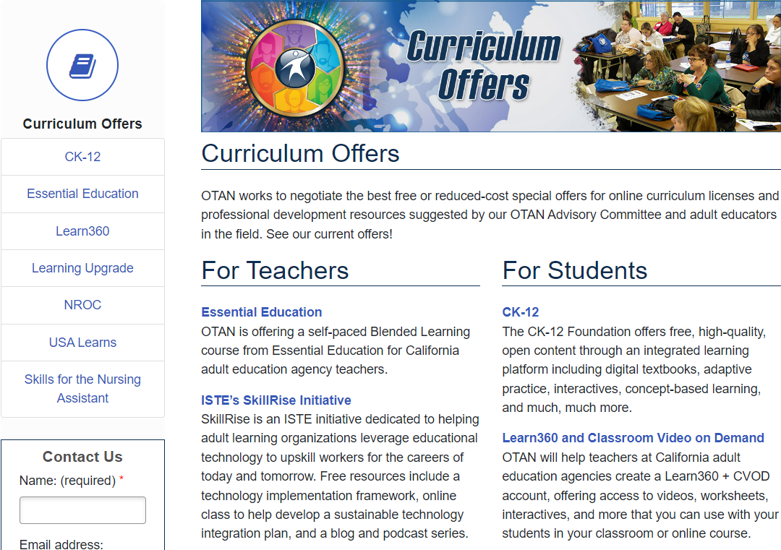
Curriculum offers
Special offers
OTAN works to negotiate free or reduced-cost special offers for online curriculum licenses and PD resources.
Essential Education – for blended learning teaching
Northstar Digital Literacy
Learn360 – online resources for all programs
And more!

Slide 13
Access to CANVAS LMS
California distance learning cooperative: a canvas project
No-cost instance (URL) for each WIOA II agency
Initial 50 Canvas licenses free on an annual basis
Statewide-leveraged pricing for licenses above 50
Statewide-leveraged services and support for all agencies

Slide 14
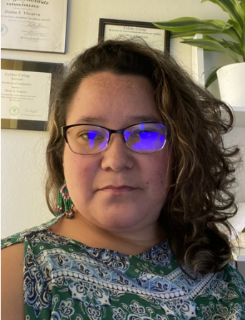
Adult education students succeed
STUDENT SHOWCASE
Celebrate what adult education learners have achieved
Nominate a student via the website adultedlearners.org
Application process is open from January 1 through April 1 – recipients are notified in May
2022 Award Recipient
Notes:
https://adultedlearners.org/Students/Video/324

Slide 15
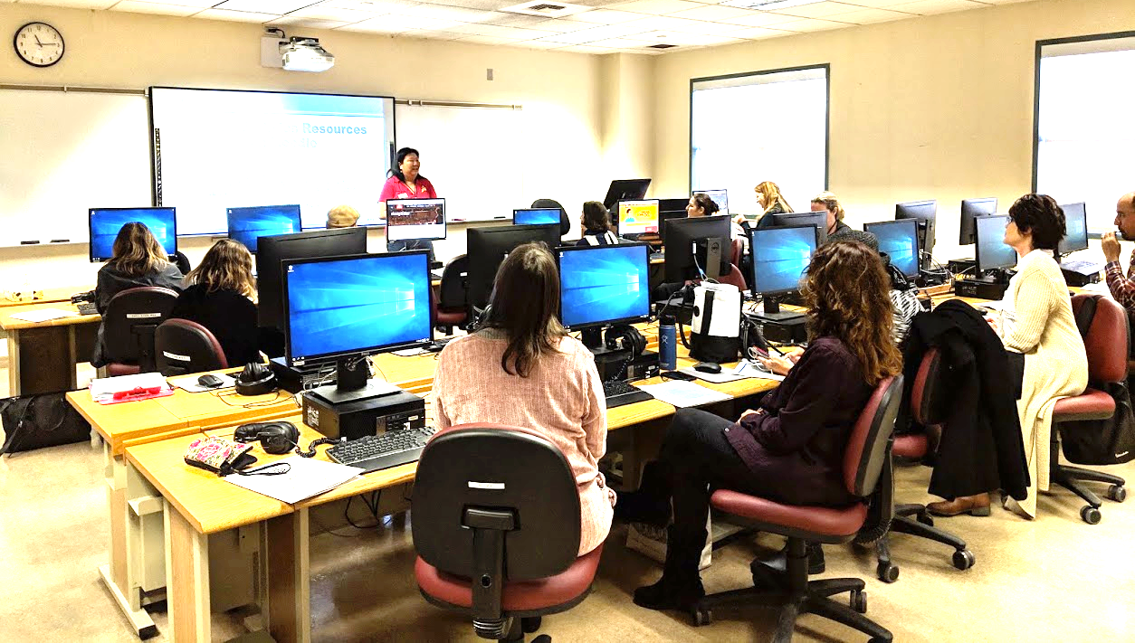
OTAN training
Face-to-face and online
Face-to-face workshops are 3 to 4 hours in length.
Online workshops are 1 to 1.5 hours in length.
All workshops have “hands on” activities and modeling.
OTAN workshops can be customized to meet the needs of a requesting agency.
OTAN workshops are free!

Slide 16
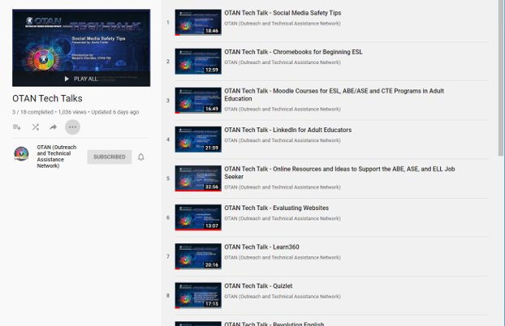
OTAN tech talks
OTTs are scheduled monthly as webinar presentations
OTTs address how to implement technology in the classroom or program wide
OTTs are archived on the OTT Video Presentations page.

Slide 17
OTher training opportunities
Find OTAN at other conferences…

Slide 18
TDLS
The Technology and Distance Learning Symposium (TDLS)

Slide 19
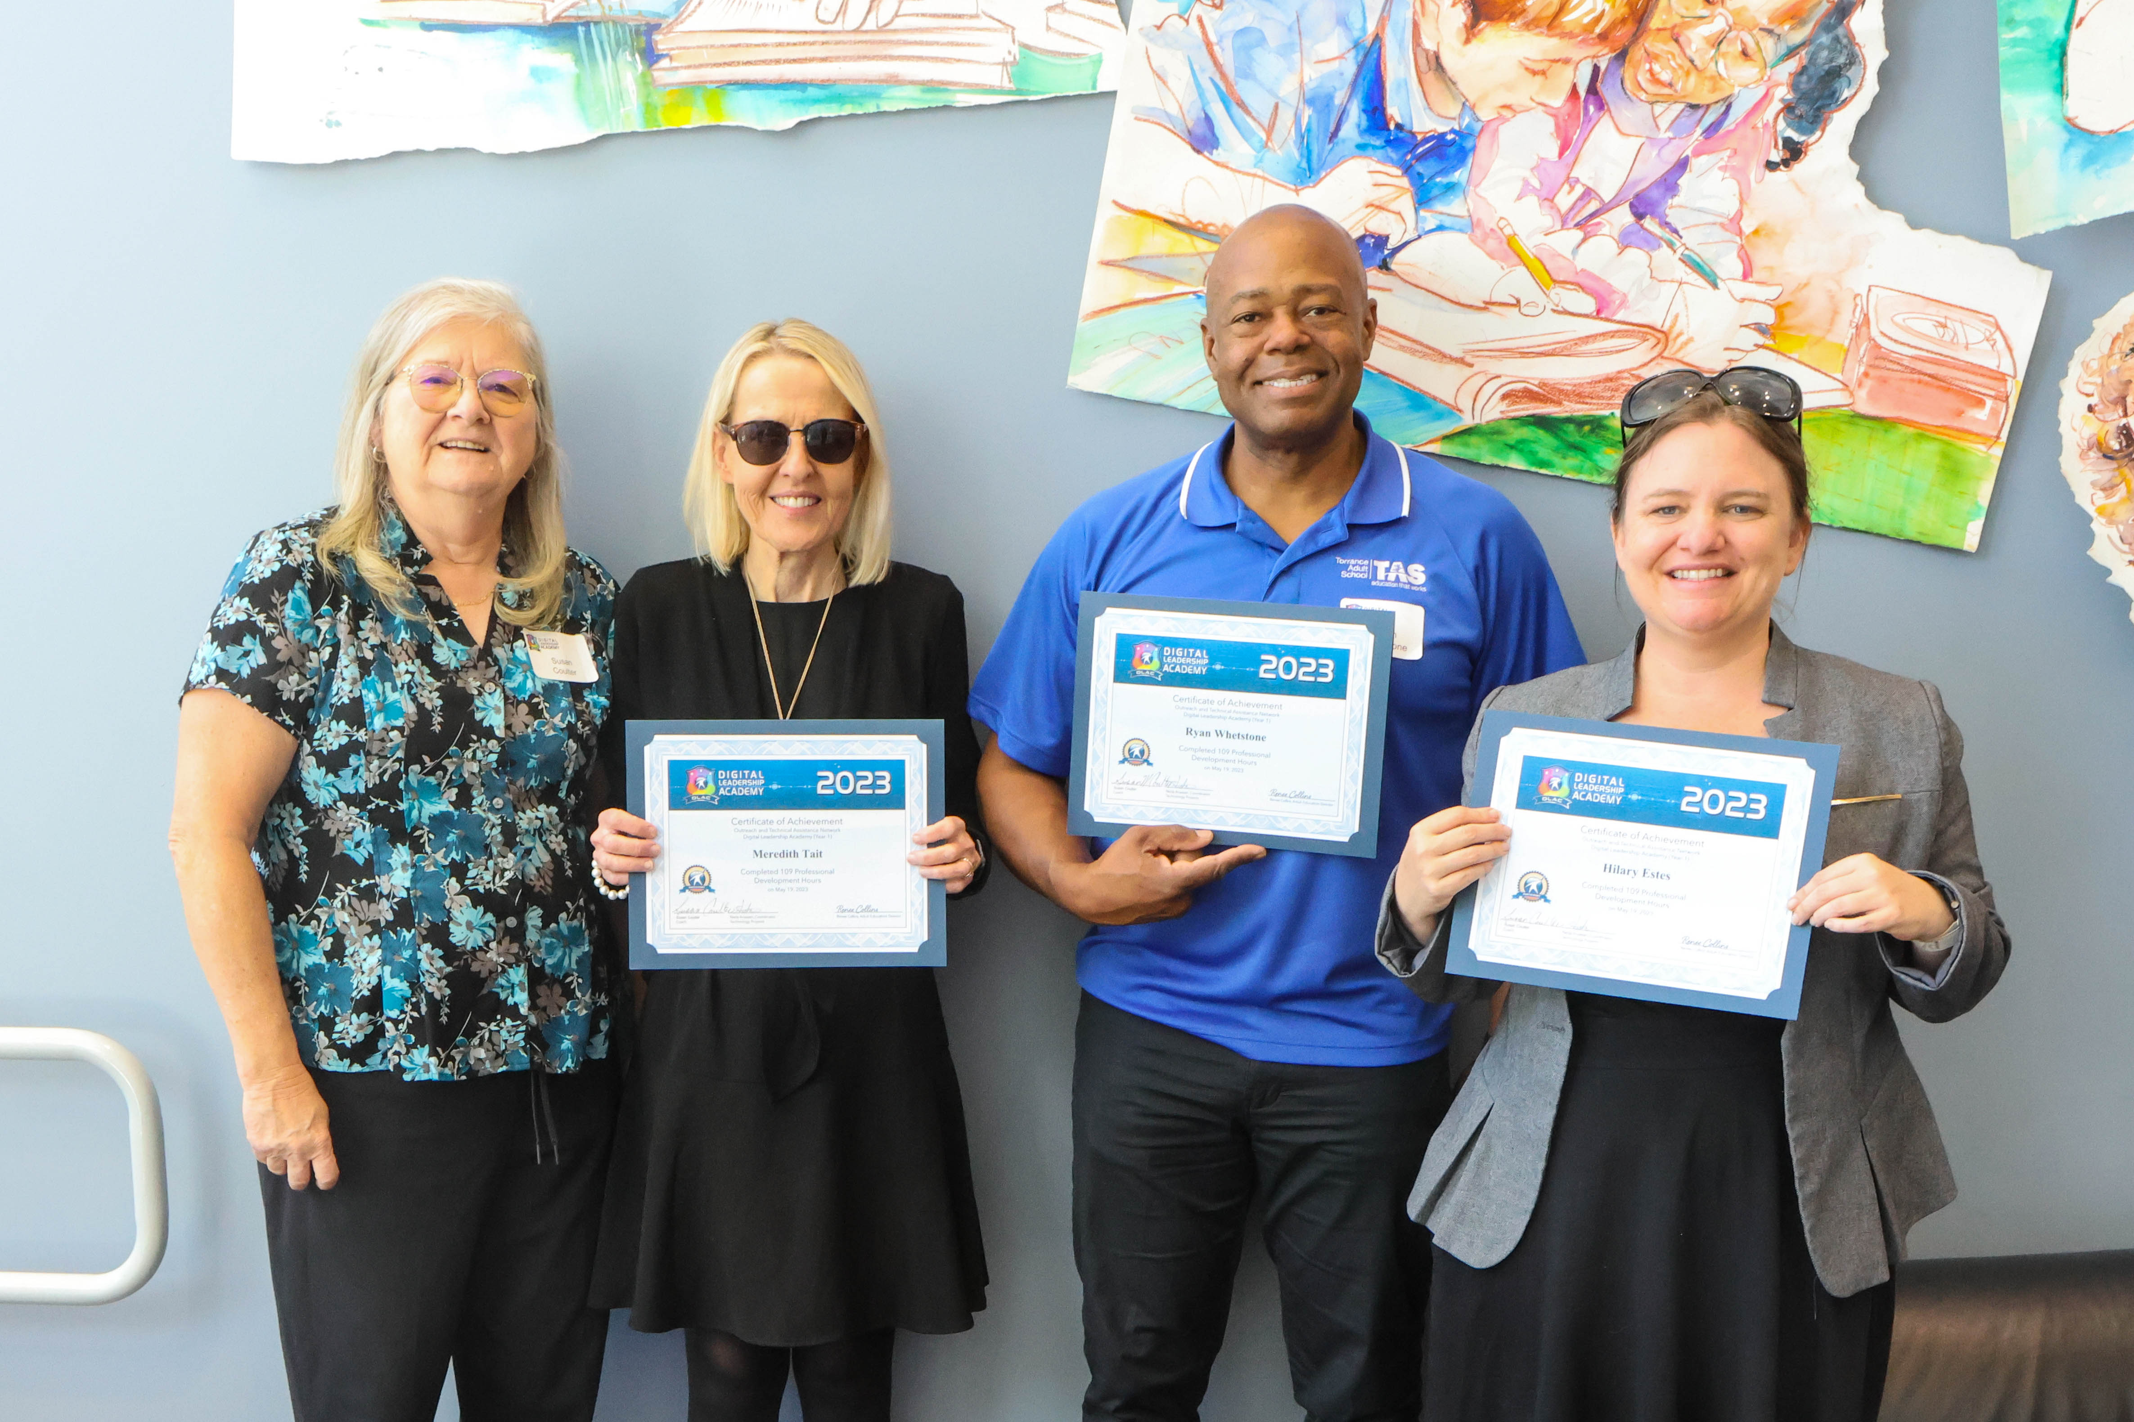
DLAC
DLAC (Digital Leadership Academy)

Slide 20
Staying connected – social media
OTAN on Social Media
Twitter twitter.com/otan or @otan
Facebook facebook.com/otanservesadulteducation
LinkedIn linkedin.com/company/otan_2
YouTube channel – youtube.com/otanservesadulteducation

Slide 21
END SLIDE

